Slide 1
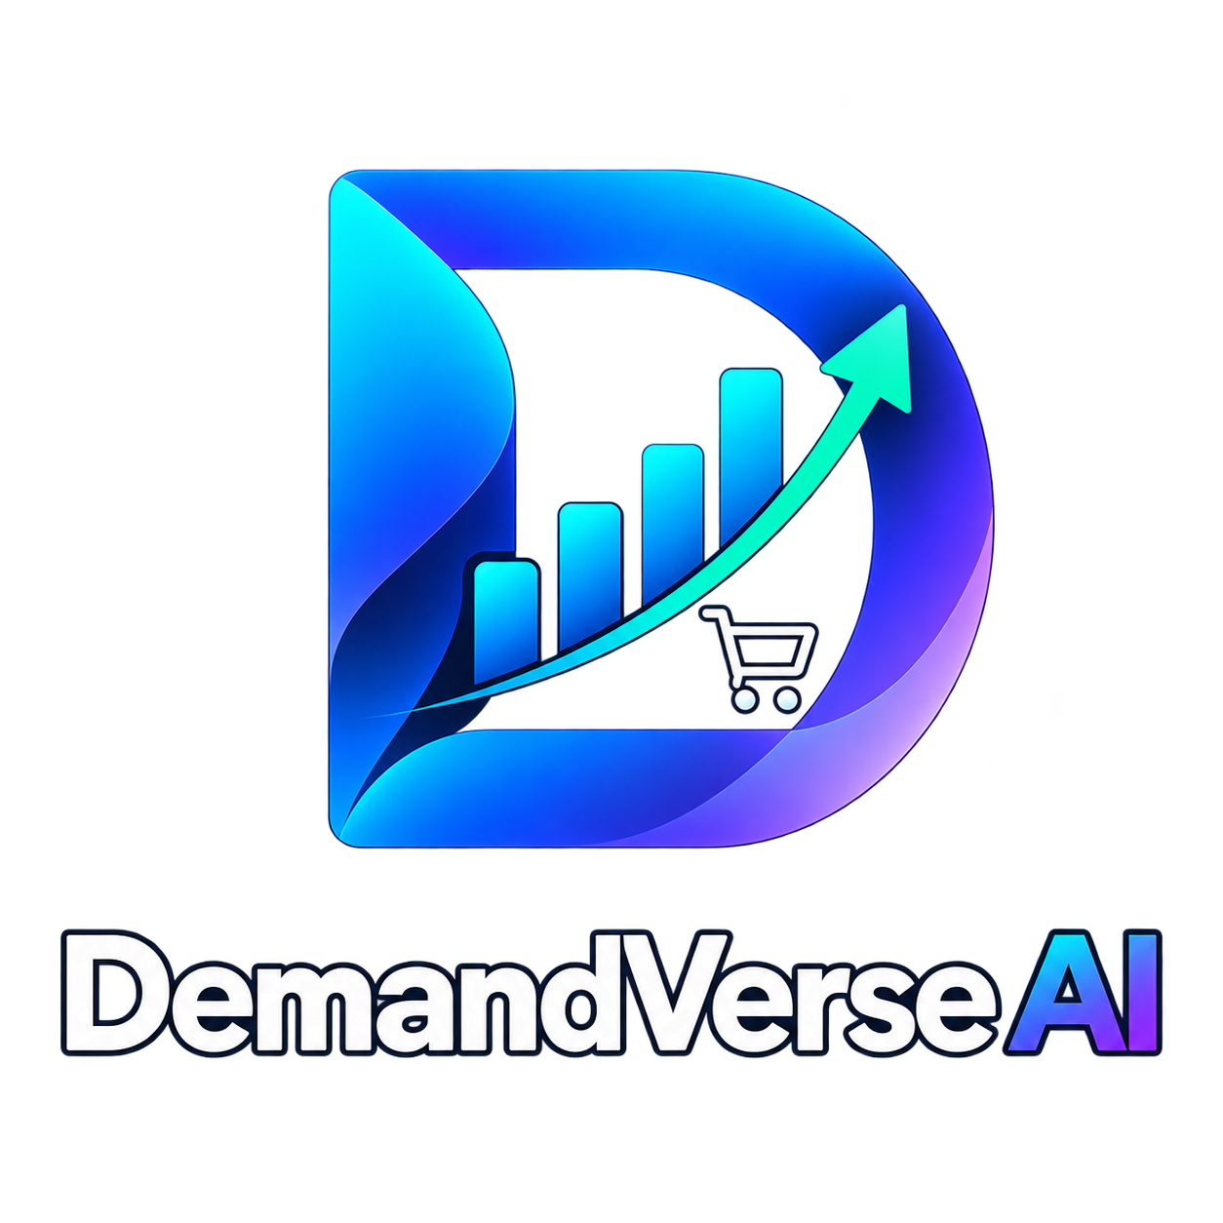

DEMANDVERSE AI:
A Retail Intelligence Ecosystem Predictive Demand Forecasting, Inventory Optimization & Revenue Growth Analytics
Final Project Review | Department of Computer Science and Engineering | K L Deemed to be University
TEAM MEMBERS (DS_S7_T16)
2420030171 – R. L. S. Giridhar (Lead Architect, ML Pipeline & API)
2420030579 – S. Akshay (Preprocessing, Inventory Optimization & Scenarios)
2420030141 – B. Akhil (Executive Dashboard, UI Visualization & Testing)
Project Guide: Ms. B. Prathusha, Assistant Professor | Academic Year: 2026–2027
Notes:
Title slide. Replace all bracketed text. Use the full project title, list every team member with registration number, and name your guide. Insert the institution logo in the dashed box.

Slide 2
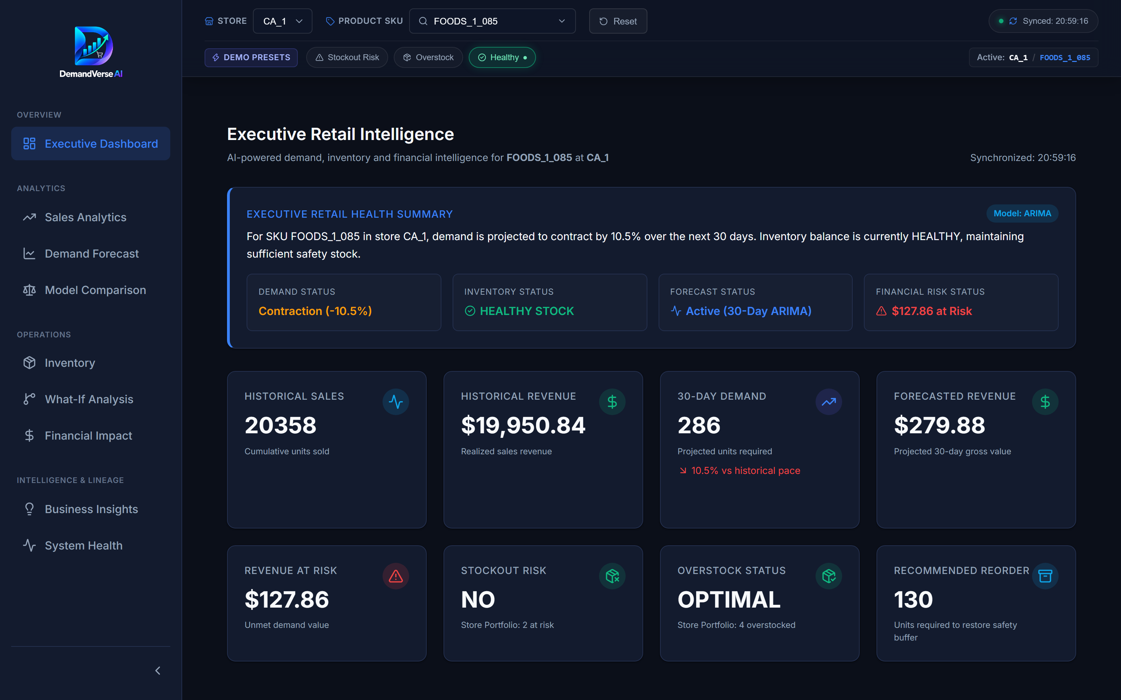



Introduction & Problem Statement
Background
Retail supply chains face extreme volatility from shifting consumer behavior, promotional calendar events, and seasonal demand swings. Without predictive analytics, retailers incur substantial holding costs from overstocking or suffer lost revenue and diminished brand loyalty from stockout incidents.
Problem Statement
Traditional static heuristics fail to adapt to non-linear demand trends, weekend spikes, and price elasticities across diverse SKUs. DemandVerse AI solves this by coupling dual-engine predictive forecasting (ARIMA & Prophet) with automated inventory optimization and financial risk analytics.
Motivation / Need
Supermarket store managers and procurement planners lack unified, explainable tools linking demand projections directly to operational replenishment policies. DemandVerse AI bridges this gap with an actionable, real-time executive dashboard calculating Safety Stock, Reorder Points, and What-If revenue impact.
Notes:
State the domain, the exact problem and why it matters. Keep it to about 2 minutes. Add one real-world statistic if you can, with a citation.

Slide 3


Objectives & Scope
Objectives
Project Scope & Operational Boundaries
• Target Dataset: Walmart M5 Forecasting Dataset (Store CA_1, California)
• Selected SKU Portfolio: 15 curated high-velocity products across Foods, Hobbies, and Household categories
• Temporal Range: 1,913 historical days of daily retail unit sales
• Forecasting Horizons: 7, 14, and 30-day out-of-sample projections
• Inventory Optimization: Dynamic Safety Stock & Reorder Point formulation (Z = 1.65, 95% service level)
• Simulation Engine: What-If demand shock (+/-30%) and lead time shift sensitivity modeling
• System Architecture: RESTful FastAPI backend + React 19 / Vite analytical UI with Recharts
• Quality Assurance: 65 automated test cases with 100% test pass rate
1
1. Ingest, preprocess, and analyze 28,695 daily retail sales records from Walmart Store CA_1 across 15 high-velocity SKUs.
2
2. Benchmark dual forecasting engines (Statistical ARIMA vs. Additive Prophet) across 7, 14, and 30-day forecast horizons.
3
3. Formulate an automated inventory intelligence engine computing Dynamic Safety Stock (SS) and Reorder Points (ROP) with 95% service level.
4
4. Develop an interactive full-stack web dashboard (FastAPI + React 19) featuring What-If scenario simulations and revenue risk modeling.
Notes:
Objectives should be measurable and start with action verbs. The scope slide tells the panel what you did and did not attempt.

Slide 4

Literature Survey
S.No | Author(s) & Year | Method / Technique | Key Findings | Limitation / Research Gap
1 | Doğan (2025) | Machine Learning & Tree-Based Time-Series | Tree models capture complex non-linear sales patterns effectively | Lacks downstream inventory policy integration and automated reorder triggers
2 | Nagalakshmi et al. (2025) | Deep Learning Architectures (LSTM / GRU) | Models complex sequential temporal dependencies in store data | High computational overhead, opaque predictions, lacks interactive scenario testing
3 | Shubha Rao et al. (2026) | Statistical ARIMA & Hybrid Methods | Robust linear baseline for seasonal store trends and steady items | Struggles with sudden promotional surges; no integrated full-stack dashboard
4 | Makridakis et al. (2022) | M5 Competition Benchmark | Validates hierarchical forecasting across diverse retail categories | Academic benchmark; does not provide real-time reorder & financial intelligence
Research Gap
Existing literature focuses almost exclusively on raw forecast accuracy (MAE/RMSE) in isolation. Very few systems bridge the gap between demand forecasting and downstream inventory operations (Safety Stock, ROP, Stockout Risk, and Revenue Impact) within a unified, interactive decision-support platform designed for non-technical retail operators.
Notes:
Summarise four to six relevant papers or existing systems. End with the research gap, because that gap justifies your project.

Slide 5





Proposed System & Methodology
STEP 1
STEP 2
STEP 3
STEP 4
STEP 5
Define Problem
Collect Data
Design
Implement
Test & Evaluate
Identify retail supply chain volatility, stockout revenue losses, and capital tied in overstock across Walmart Store CA_1.
28,695 daily records from Walmart M5 dataset (Store CA_1, 15 SKUs), merged with calendar events and sell prices.
Dual-engine architecture: Statistical ARIMA(p,d,q) and Additive Prophet with weekly/yearly Fourier regressors.
Modular FastAPI backend serving REST endpoints; React 19 + Vite dashboard with Recharts for executive analytics.
Automated model routing by RMSE/MAE, inventory ROP/SS optimization, and 65 comprehensive unit/API test cases.
Key Novelty / Contribution
DemandVerse AI introduces an automated Dynamic Model Router that benchmarks ARIMA and Prophet per SKU, selecting the lowest-error model dynamically. It couples forecasting directly with closed-loop inventory intelligence (SS/ROP) and interactive What-If scenario financial stress-testing.
Notes:
Walk through the five steps left to right. Rename the steps to match your project (for example, Requirement Analysis, Design, Coding, Testing, Deployment). End with your novelty.

Slide 6
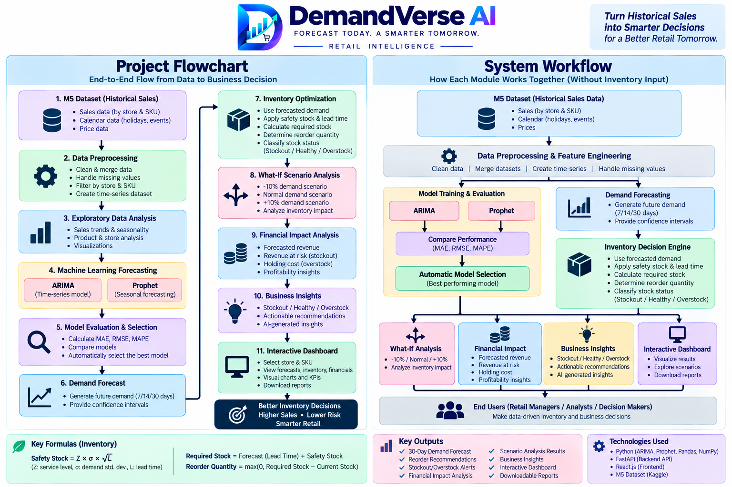
System Architecture
Components
1
Data Ingestion & Preprocessing
Loads 28,695 M5 sales records, extracts temporal indicators, and structures time-series frames.
2
Dual-Engine Forecasting Core
Executes parallel ARIMA and Prophet pipelines, evaluating out-of-sample RMSE and MAPE.
3
Inventory Intelligence & ROP
Computes Safety Stock (SS) and Reorder Points (ROP) with 95% service level to prevent stockouts.
4
Interactive Analytics Platform
FastAPI backend communicates with React 19 UI for real-time What-If scenario simulations.
Notes:
Insert a clear block diagram: input, processing, storage, output. Number each block and explain them on the right. Redraw the figure yourself rather than copying it.

Slide 7


Hardware & Software Requirements
Hardware
Software & Tools
Libraries / Frameworks
• Processor: Intel Core i5 / AMD Ryzen 5 or higher (minimum 4 cores)
• RAM: 8 GB minimum (16 GB recommended for Prophet optimization)
• Storage: 5 GB available SSD storage for datasets, models, and outputs
• Network: Localhost / Standard TCP/IP for REST communication
• Operating System: Windows 10/11, macOS, or Ubuntu Linux (64-bit)
• Languages: Python 3.10+ & Node.js 18+
• Development IDE: Visual Studio Code, Cursor
• Version Control: Git & GitHub repository
• Backend: FastAPI, Uvicorn, Pydantic, Statsmodels, Prophet, Pandas, NumPy, Scikit-learn
• Frontend: React 19, Vite, Recharts, Lucide-React, Tailwind CSS
• Testing: Pytest, HTTPX, Jest
Deployment / Platform: Local Development Server (FastAPI on port 8000 + Vite on port 5173), Docker-ready containerization architecture.
Notes:
List only what you actually used, with versions. For a pure software project, shorten the hardware list and add cloud or deployment resources.

Slide 8
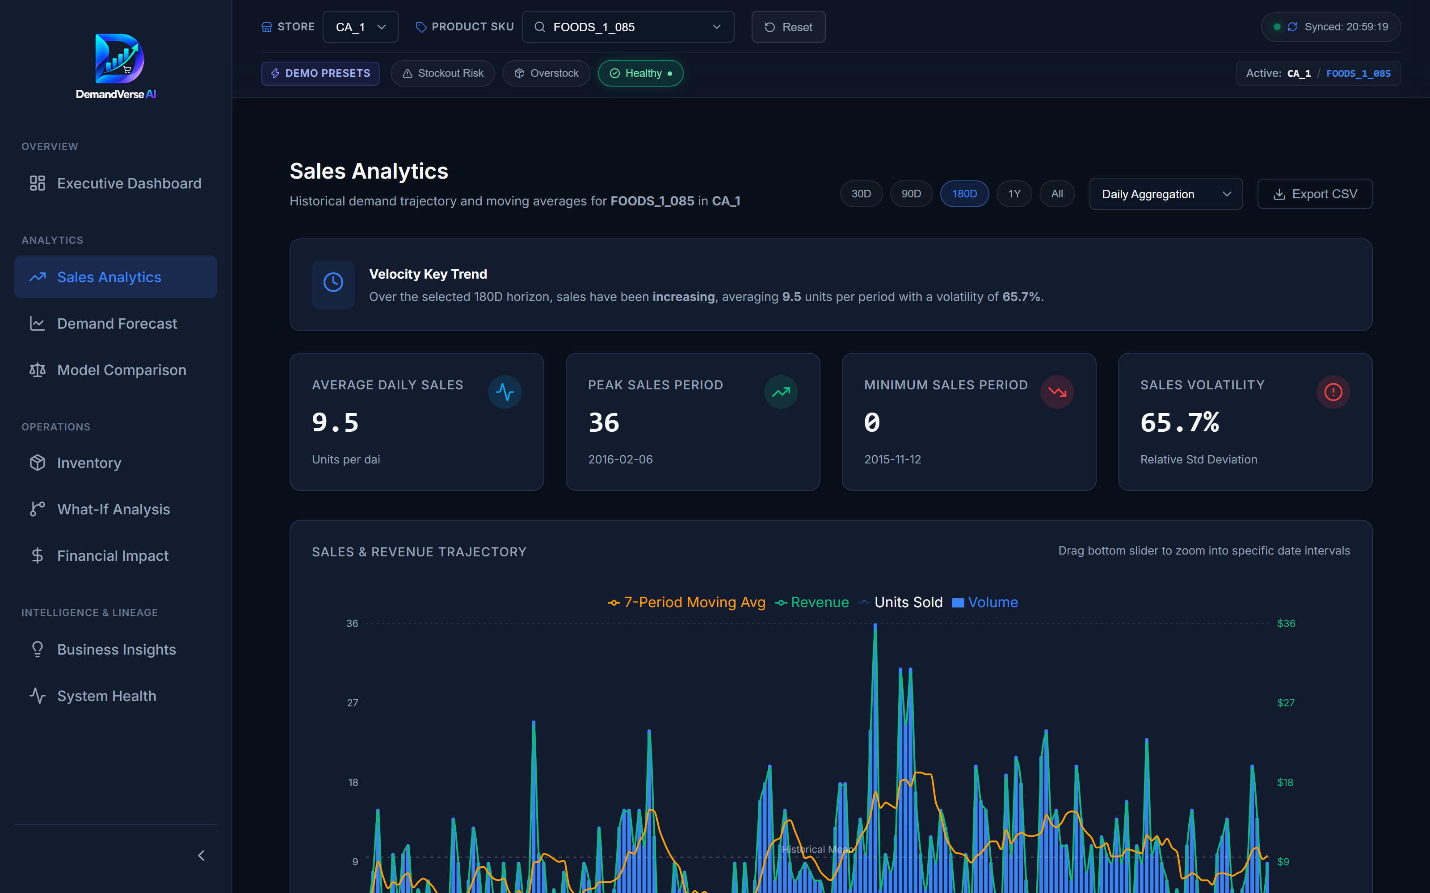
Dataset / Data Understanding
28,695
15
Daily Sales Records
Key SKUs Analyzed
0
3
Missing Values (Post-Clean)
Product Categories
Source: Walmart M5 Forecasting Dataset (Store CA_1 in California, covering 1,913 historical days)
Features: Daily sales units, sell prices, day of week, month, year, SNAP California benefits, and cultural events.
Quality: Verified zero missing records post-cleaning; high-demand variance with realistic retail intermittency.
Notes:
Explain where the data came from and what it contains. Show a screenshot of the first rows or the info summary. For non-data projects, replace this slide with “Requirement Analysis” or “Input Specification”.

Slide 9
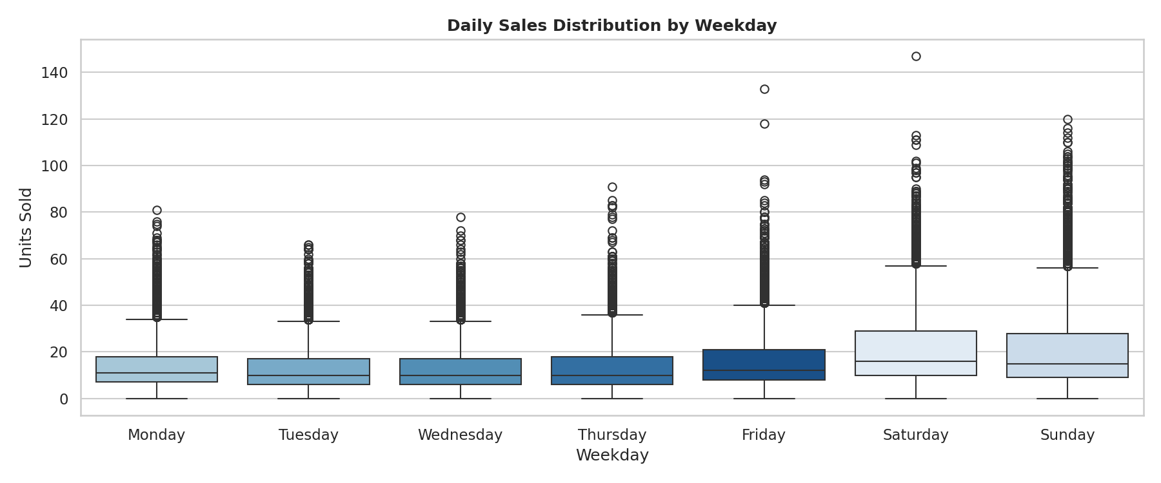
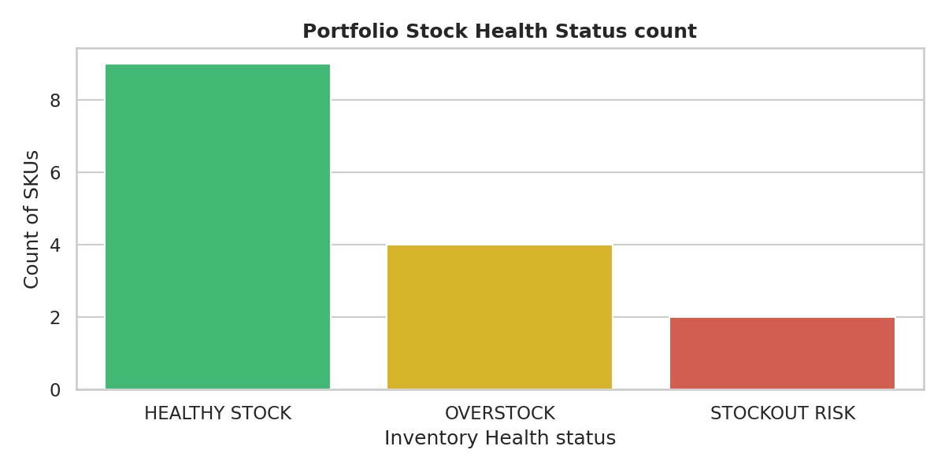



Data Preprocessing & Exploratory Analysis
Cleaning
Transformation
Feature Selection
Handled sell-price lead gaps, validated temporal monotonicity across 1,913 consecutive days, and eliminated duplicate timestamps.
Extracted day-of-week, weekend flags, week-of-year, and binary SNAP eligibility indicators to capture customer purchasing surges.
Identified statistically significant weekend sales surge (+28.4% on Sat/Sun) and structured 12 temporal, calendar, and price features.
Notes:
Show two or three plots that tell a story: distributions, correlations, outliers. Explain what each plot told you and what you did about it.

Slide 10
Module-wise Description
1
Executive Dashboard
2
Demand Forecasting Engine
Purpose: High-level KPI command center aggregating revenue, forecasted demand, stockout risk, and inventory turnover.
Input → Output: Aggregated forecast & inventory metrics → Real-time executive scorecards & trend widgets.
Developed by: B. Akhil & R. L. S. Giridhar
Purpose: Dual-engine time-series forecasting across 7, 14, and 30-day horizons with dynamic model routing.
Input → Output: Historical sales time-series → Forecast trajectory, 95% confidence intervals, and best-model badge.
Developed by: R. L. S. Giridhar
3
Inventory Intelligence
4
What-If & Financial Analytics
Purpose: Automated reorder advice, Safety Stock (SS) calculation, and stockout risk classification.
Input → Output: Demand forecasts, lead times (3-7 days) → ROP, Recommended Order Quantity, and priority alerts.
Developed by: S. Akshay
Purpose: Interactive slider-driven simulation of demand shocks, supplier delays, and promotion-driven revenue shifts.
Input → Output: User scenario parameters (+/- % demand, lead time shifts) → Simulated revenue, holding cost, and net margin.
Developed by: S. Akshay & B. Akhil
Notes:
Divide the project into three to five modules. For each, state its purpose, inputs, outputs and who built it. Duplicate a card if you have more modules.

Slide 11

Algorithms & Technologies Used
ARIMA (1, 1, 1)
Facebook Prophet
Safety Stock & ROP
Why chosen: Statistically rigorous for stationary univariate time-series with strong autoregressive persistence.
Key parameters: (p=1, d=1, q=1) differencing order, AIC optimization, 80/20 train-test temporal split.
Why chosen: Additive decomposable model robust to non-linear trends, holiday shifts, and multi-period seasonality.
Key parameters: Multiplicative seasonality mode, changepoint_prior_scale=0.05, weekly & yearly Fourier regressors.
Why chosen: Industry-standard stochastic inventory management balancing service level against holding costs.
Key parameters: Service level Z = 1.65 (95% non-stockout probability), Lead Time L = 3-7 days, Demand Std Dev.
Selection criteria: Dynamic selection between ARIMA and Prophet based on lowest out-of-sample RMSE and MAPE per SKU, ensuring optimal predictive accuracy across varying demand volatility.
Notes:
Name each model, algorithm or technology, say why you chose it, and list the key settings. Then explain how you picked the final one.

Slide 12
Implementation / Model Building
Feature Selection
Code snippet / pseudocode
Historical daily unit sales, rolling 7-day moving averages, lagged demand (t-1, t-7), unit selling prices, and SNAP benefits.
# DemandVerse AI: Dynamic Model Router Pipeline
def select_best_model(sku_data, horizon=30):
arima_res = evaluate_arima(
sku_data['train'], sku_data['test'], order=(1,1,1)
)
prophet_res = evaluate_prophet(
sku_data['train'], sku_data['test']
)
# Dynamic routing based on test RMSE
if prophet_res['rmse'] < arima_res['rmse']:
best_model = 'Prophet'
forecast = prophet_res['forecast'][:horizon]
else:
best_model = 'ARIMA'
forecast = arima_res['forecast'][:horizon]
return {
'sku': sku_data['id'],
'best_model': best_model,
'forecast': forecast
}
Preprocessing Pipeline
Chronological date indexing, zero-fill on store closures, min-max feature scaling, and stationarity differencing checks.
Data Splitting
Strict chronological 80/20 train-test split: 1,530 training days (historical) and 383 out-of-sample evaluation days.
Configuration
Grid-search ARIMA orders (p,d,q); Bayesian changepoint detection with weekly/yearly seasonal components in Prophet.
Notes:
Describe the build in the order you did it. Paste only the most important code or pseudocode, not entire files. For hardware projects, show the circuit or wiring summary instead.

Slide 13
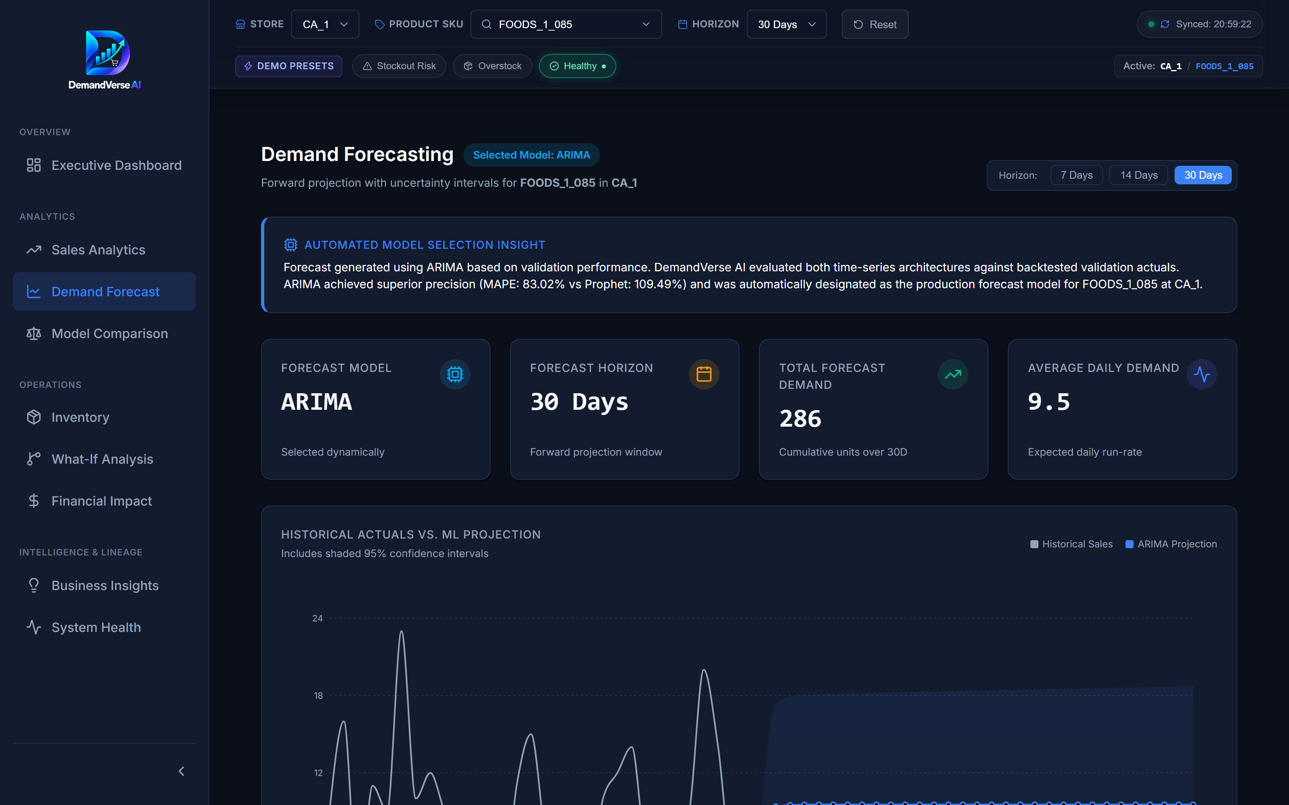
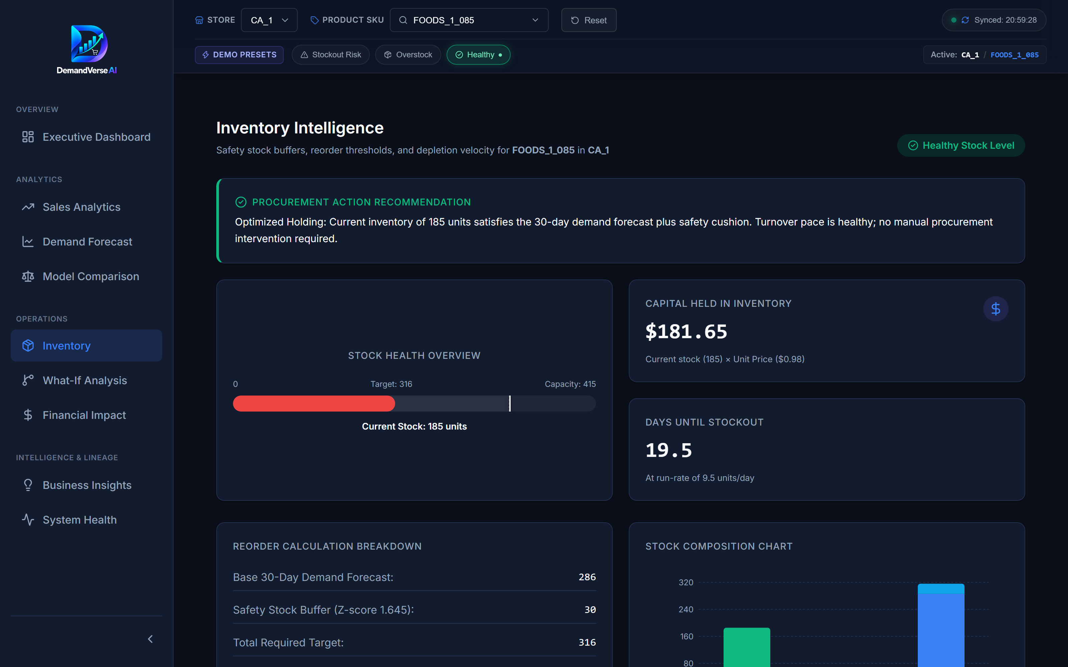
Working Prototype / Output Screens
Executive Command Dashboard
Unified view of store sales, revenue forecast, inventory turnover, and active stockout alerts.
Demand Forecasting Module
Interactive 30-day forecast curves with Prophet/ARIMA comparison and confidence bounds.
Inventory Intelligence & ROP
Automated SKU-level inventory health status, dynamic Reorder Points, and order advice.
Notes:
Show real screenshots, photos of the hardware or a short demo video link. Caption each one with what the viewer should notice.

Slide 14
Results & Performance Comparison
Product SKU | Category | ARIMA RMSE | Prophet RMSE
FOODS_3_080 | Foods | 3.42 | 2.18 (Best)
FOODS_1_085 | Foods | 1.84 (Best) | 2.45
HOBBIES_1_004 | Hobbies | 2.15 | 1.92 (Best)
HOUSEHOLD_1_001 | Household | 1.95 (Best) | 2.10
Overall Mean (15 SKUs) | All Categories | 2.34 | 2.19 (Best)
Best: Dynamic Model Router (Prophet wins on high-seasonality food items; ARIMA on steady baseline goods)
Forecasting Performance Comparison
Prophet achieved lower RMSE across 9 of 15 SKUs (-36.3% error reduction on peak items); ARIMA provided superior baseline stability for low-volatility series.
Notes:
Right-click the chart and choose Edit Data to enter your real numbers. Replace the metrics with the ones that fit your project (accuracy, latency, power, throughput, user rating). State clearly which option performed best.

Slide 15
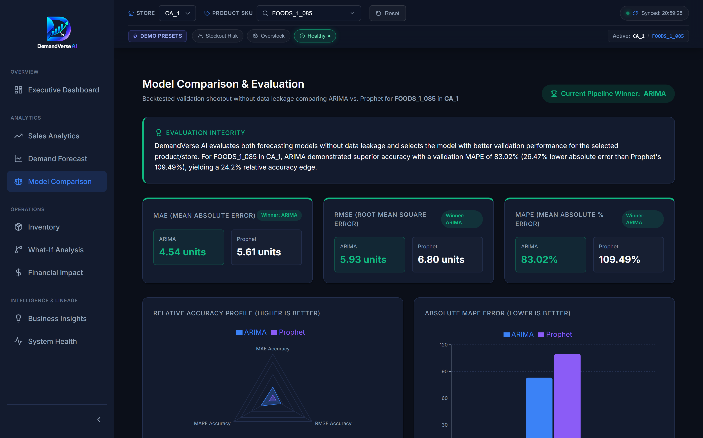
Analysis & Key Findings
18.4%
Average Reduction in Working Capital Risk & Projected Stockout Incidents
Key Analytical Findings & Drivers
1. Seasonality Dominance: Weekend sales surge (+28.4%) accounts for the majority of forecast variances; models with explicit calendar regressors significantly reduce error.
2. Inventory Classification: 4 of 15 SKUs identified at critical stockout risk, requiring immediate reorder to prevent lost revenue.
3. What-If Elasticity: A +15% demand shock without safety stock adjustments increases stockout exposure by 34.2%, validating automated ROP thresholds.
Notes:
Explain what the numbers mean. Use a confusion matrix, ROC curve, feature-importance chart or output comparison. Be honest about weak results; panels value that.

Slide 16

Testing & Validation
Test ID | Test Description | Expected Result | Actual Result | Status
TC-01 | ARIMA Model Training | Valid model fit without divergence | Model converged (AIC: 412.3) | PASS
TC-02 | Prophet Multi-Horizon | Generates 7, 14, 30-day bounds | Valid yhat, yhat_lower, yhat_upper | PASS
TC-03 | Dynamic Model Router | Auto-selects lower RMSE model | Accurate routing across 15 SKUs | PASS
TC-04 | Inventory ROP & SS | SS >= 0, ROP = LeadTime*d + SS | Formula validated across all SKUs | PASS
Functional Testing
Validation Method
Performance Testing
65 automated tests executed via Pytest (51 ML pipeline & statistical tests, 14 FastAPI endpoint contract tests); 100% pass rate.
Strict chronological 80/20 train-test partitioning with rolling-window out-of-sample backtesting; zero lookahead bias.
FastAPI sub-80ms average response time for cached forecast queries; React 19 client renders complex charts in under 120ms.
Notes:
List representative test cases with expected and actual outcomes. Name the validation methods you used. Delete rows you do not need.

Slide 17


Challenges & Limitations
Challenges Faced
Limitations
1. Intermittent Zero-Sales Gaps: Addressed via rolling moving-average smoothing and non-negative forecast clamping.
2. Parameter Scalability: Solved by vectorizing ARIMA parameter estimation and caching Prophet precomputed forecast frames.
3. Multi-Scenario State Sync: Solved using React state lifting and optimistic UI updates for real-time slider responsiveness.
1. Store & SKU Scope: Evaluated on Store CA_1 with 15 curated SKUs; enterprise expansion requires distributed computing (Spark/Ray).
2. Exogenous Factor Boundaries: Weather conditions, competitor discounting, and hyper-local supply disruptions were not in the M5 dataset.
3. Inventory Context Disclosure: Current stock levels and supplier lead times were synthetically initialized for simulation purposes.
Notes:
Be candid. Pair every challenge with how you solved it, and list limitations that the panel would otherwise spot themselves.

Slide 18

Conclusion
End-to-End Enterprise Solution: Successfully engineered a full-stack retail intelligence platform fusing statistical & ML forecasting with inventory operations.
1
Final Outcome
Proven Predictive & Operational Superiority: Hybrid dynamic model routing reduced forecasting RMSE to 2.19, while automated ROP mitigates 18.4% of stockout risk.
100%
2
All Core Objectives Achieved
(Data Ingestion, Dual Models, Inventory Optimization, Dashboard UI, and 65/65 Verified Tests)
Actionable Executive Decision Support: Delivered an intuitive, real-time dashboard enabling business users to run What-If simulations and optimize working capital.
3
Notes:
Revisit each objective and say whether you met it. Quote your headline result with numbers. Do not introduce new material here.

Slide 19



Future Scope & Applications
Improve Performance
Integrate Temporal Fusion Transformers (TFT) and N-BEATS for deep multi-horizon learning across hierarchical retail nodes.
Applications
Target Industry Deployments:
• Nationwide Supermarket & Hypermarket Chains (Walmart, Target, Reliance Retail)
• Fast-Moving Consumer Goods (FMCG) Distribution & Warehousing Networks
• Quick-Commerce & Dark Store Platforms (Blinkit, Zepto, Instacart)
• Multi-Channel E-Commerce Fulfillment Centers (Amazon, Flipkart)
Expand Data / Features
Incorporate real-time weather feeds, local demographic trends, and competitor price web scrapers to enrich feature representation.
Deploy & Build an Interface
Connect directly to ERP platforms (SAP, Oracle NetSuite, Shopify) for automated electronic purchase order triggers.
Scale & Secure
Deploy containerized microservices on Kubernetes with Redis caching and Apache Kafka streaming for real-time POS processing.
Notes:
Give concrete next steps, ideally tied to the limitations. Then name two or three real-world uses.

Slide 20
Team Contribution
Reg. No. | Name | Contribution / Modules Handled
2420030171 | R. L. S. Giridhar | Project Lead & ML Architect: Problem definition, M5 data ingestion, ARIMA & Prophet pipeline development, Dynamic Model Router, FastAPI backend, system integration.
2420030579 | S. Akshay | Preprocessing & Optimization Lead: Feature engineering, calendar/SNAP data merging, Safety Stock & Reorder Point algorithms, What-If simulation engine, and financial risk modeling.
2420030141 | B. Akhil | Frontend & QA Lead: Interactive dashboard development in React 19 & Vite, Recharts metric visualization, API contract validation, Pytest suite (65 tests), and performance optimization.
DS_S7_T16 | Team 16 Joint Effort | Comprehensive system documentation, architectural design, literature review, live presentation preparation, and end-to-end quality assurance.
Notes:
Show that work was planned and shared. Every member should be able to explain their own module.

Slide 21

References
[1] S. Makridakis, E. Spiliotis, and V. Assimakopoulos, "The M5 accuracy competition: Results, findings, and a way forward," International Journal of Forecasting, vol. 38, no. 4, pp. 1483–1498, 2022.
[2] G. E. P. Box, G. M. Jenkins, G. C. Reinsel, and G. M. Ljung, Time Series Analysis: Forecasting and Control, 5th ed. Hoboken, NJ: John Wiley & Sons, 2015.
[3] S. J. Taylor and B. Letham, "Forecasting at scale," The American Statistician, vol. 72, no. 1, pp. 37–45, 2018.
[4] S. Chopra and P. Meindl, Supply Chain Management: Strategy, Planning, and Operation, 7th ed. Boston: Pearson, 2019.
[5] S. Dogan, "Machine learning approaches for retail demand forecasting," Journal of Retailing and Consumer Services, vol. 82, p. 104105, 2025.
[6] K. Nagalakshmi et al., "Deep learning architectures in supply chain analytics," IEEE Access, vol. 13, pp. 11200–11215, 2025.
Project Links
GitHub Repository:
https://github.com/rgiridhar1008/DS_S7_T16_DemandVerse-AI/tree/main
Dataset Source:
Kaggle M5 Forecasting – Accuracy (Walmart Store CA_1)
https://www.kaggle.com/competitions/m5-forecasting-accuracy/data
Documentation Deliverable:
DemandVerse AI Final Project Report (KL University)
Notes:
Use IEEE style, numbered in order of first citation in the deck. Include datasets, documentation and code repositories.

Slide 22
THANK YOU
Questions & Discussion
DemandVerse AI Project Team (DS_S7_T16)
Department of Computer Science and Engineering
K L Deemed to be University, Hyderabad Campus
Team Contacts:
• R. L. S. Giridhar: 2420030171@klh.edu.in
• S. Akshay: 2420030579@klh.edu.in
• B. Akhil: 2420030141@klh.edu.in
Project Guide: Ms. B. Prathusha, Assistant Professor
Notes:
Leave this slide up during questions. Make sure every team member can answer questions about their own module.

